Slide 1


Collaboration In Artificial Intelligence
Automation of MA-STRIPS problem
Gym – Model Problem
Instructor: Prof. Roni Stein
By: Gil Hatav, Netanel Prat

Slide 2
Introducing the problem:
Creating training programs for trainees that arrive to the gym.
We have number of trainees that want to train in the gym at specific time.
Each trainee has a training program he wants to achieve during the session.
In the gym there are standalone exercises and collaborative exercises.

Slide 3
The Goal:
Plan the shortest training program for trainees as a group
while preserving privacy of trainee’s training program

Slide 4

Formalizing the problem:
Trainees: $Agents=\left\{A_{i} \right|i∈[1,n]\}$
Collaborative Exercises : CE = $\left\{\text{′}\text{Squat}\text{′}\text{, }\text{′}\text{Deadlift}\text{′}\text{, }\text{′}\text{BenchPress}\text{′}\text{, }\text{′}\text{Arms}\text{_}\text{SeatedInclineDumbbellCurl}’ \right\}$
Standalone Exercises : SE = $\left\{\text{′}\text{Lunges}\text{′}\text{, }\text{′}\text{PushPress}\text{′}\text{, }\text{′}\text{PushUps}\text{′}\text{, }\text{′}\text{PullUps}\text{′}\text{, }\text{′}\text{Back}\text{_}\text{TBarR}\text{′}\text{Back}\text{_}\text{30}\text{DegreeLatPulldown}’ \right\}$
Training Program: $TR=\left\{TR_{i} \right| i∈\left[1,n\right] ∧TR_{i} ⊆CE ∪SE\}$
Objective Function: MakeSpan

Slide 5
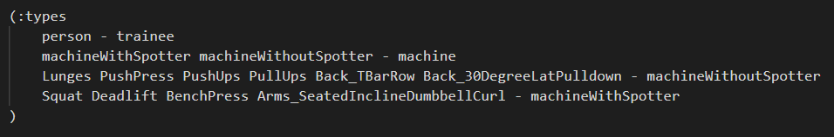
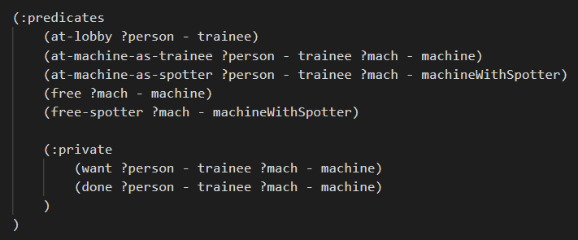
Types & Predicates

Slide 6
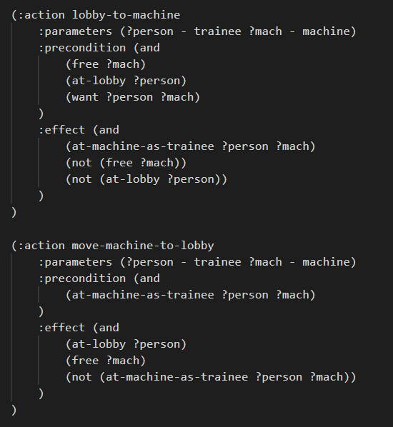
Actions

Slide 7
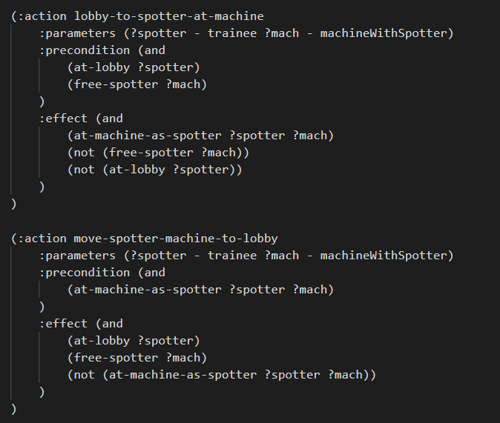
Actions

Slide 8
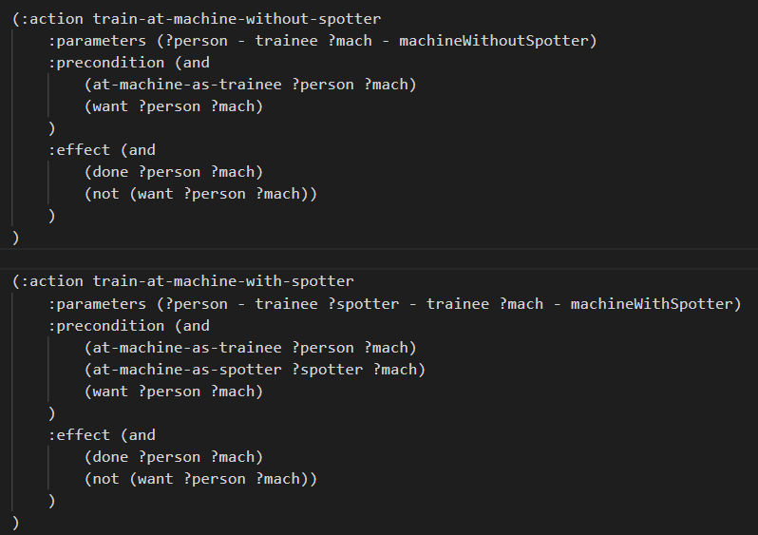
Actions

Slide 9
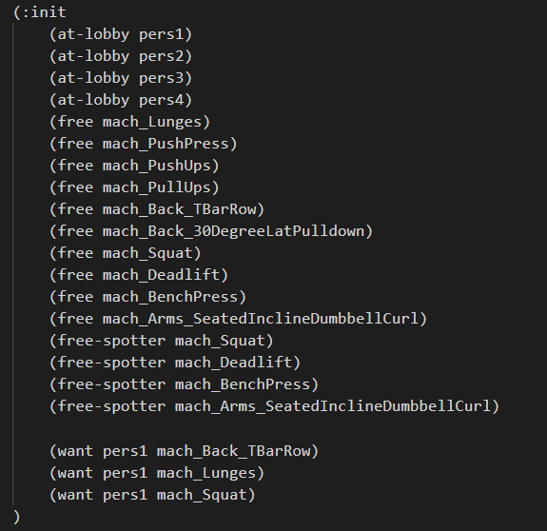
Init

Slide 10
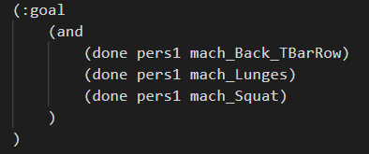
Goal

Slide 11
Our work:
We have created a generic generator for the gym – model problem .
We have created a generic template for the problem.
The generator generates the PDDL domain and problem files.
The generator has 2 modes:
Fully automation - according to given parameters (#agents, #min_CE, #max_CE, #min_SE, #max_SE).
Manual automation - creating by reading files.

Slide 12

Illustraion:

Slide 13
Results

Slide 14
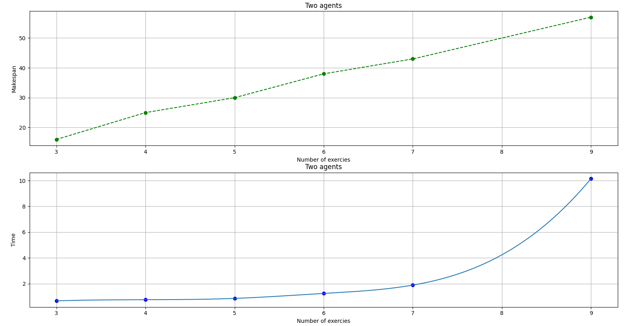

Slide 15
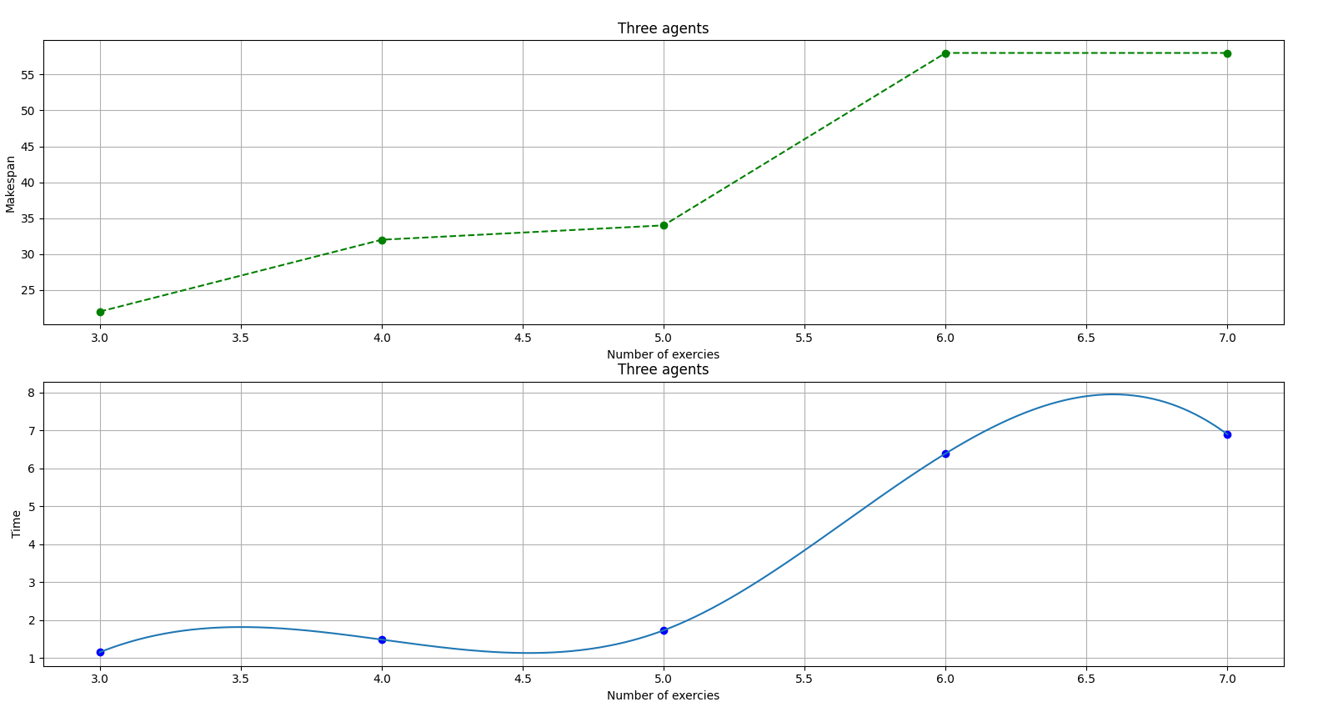

Slide 16
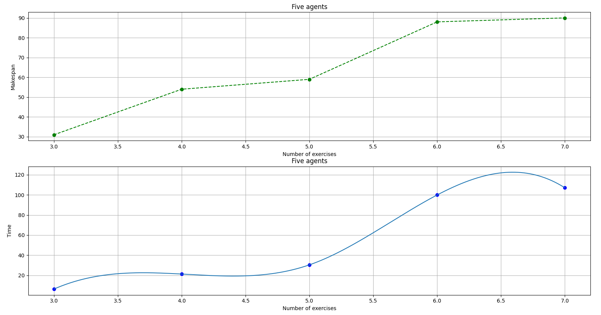

Slide 17
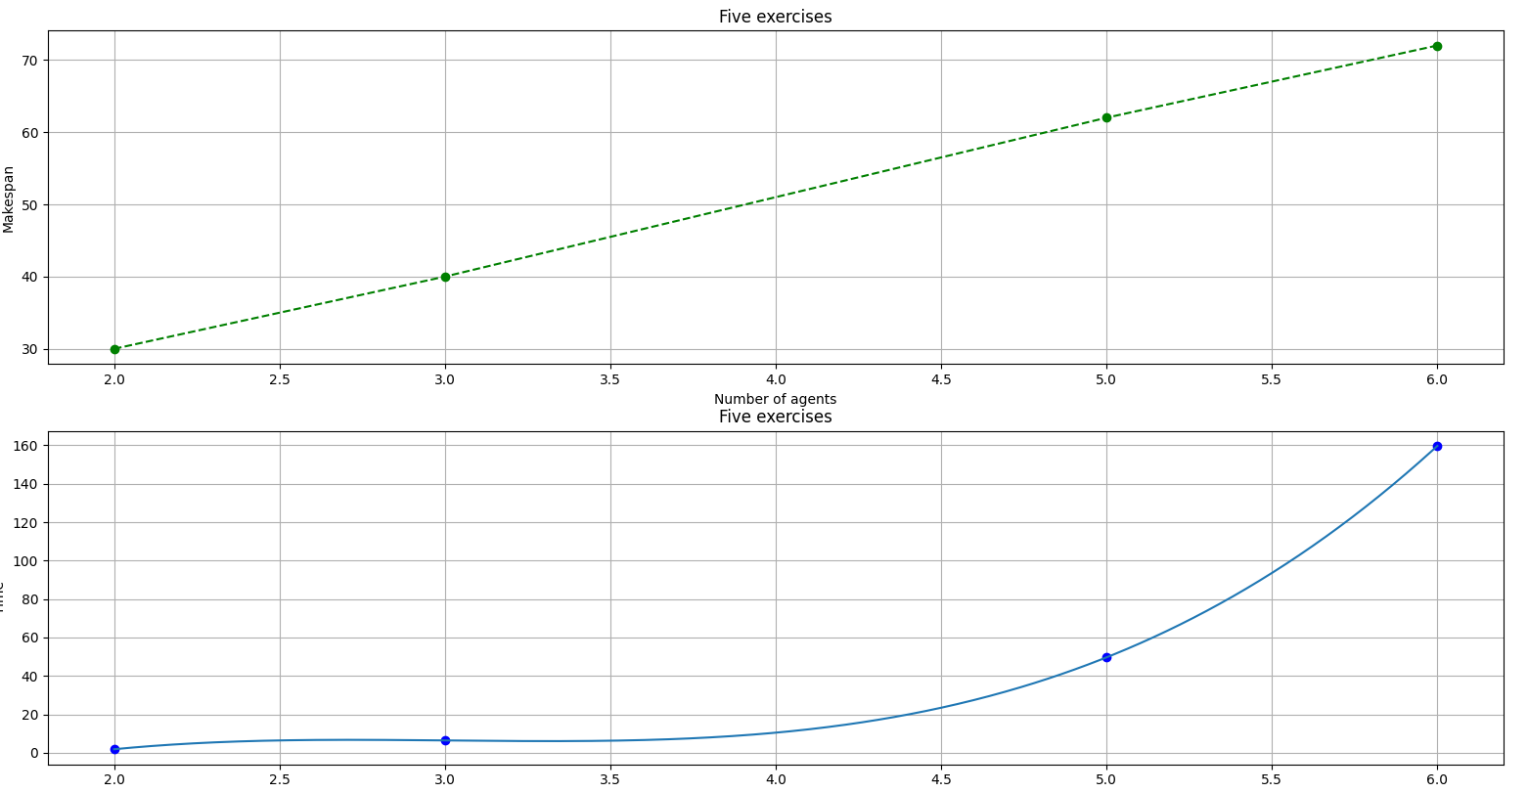

Slide 18
Questions

